Slide 1
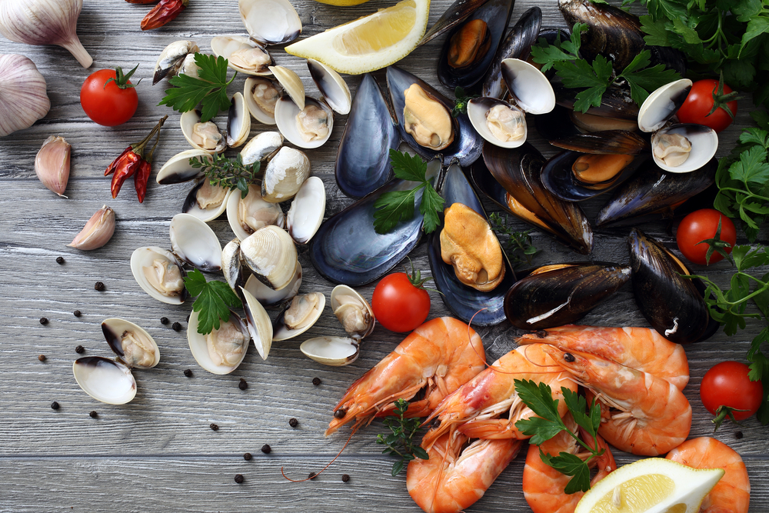
Better Seafood Board (BSB) Economic Integrity Training (for Line Employees)

Slide 2
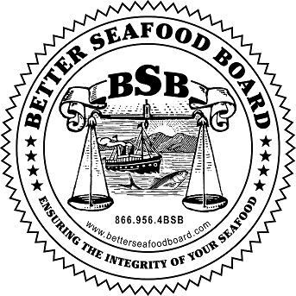
Our company takes pride in its membership in the National Fisheries Institute (NFI) and the Better Seafood Board (BSB).

Slide 3
As an NFI member, we have pledged to conduct business in an honest and trustworthy manner.

Slide 4
Honesty and trustworthiness are important to our business because:
It builds credibility with our customers, NGO’s, regulatory bodies, and the media.
It holds down overall costs of doing business.
It maintains ongoing purchasing relationships.
It provides a positive work environment.
It provides a positive image of our company.
It protects our brand.

Slide 5
Not following principles of best practices can lead to:
Loss of brand confidence.
Loss of sales.
Decreased credibility with customers.
Detrimental media recognition.
Think You Bought Red Snapper? Don’t Be So Sure
Beware of fish fraud: The supply chain for seafood is opaque, and most white-fleshed fish looks similar when filleted

Slide 6
Four things that NFI members pledge to uphold:
That our products are correctly labeled for weights and counts.
That our products are correctly labeled for identity and that species are not substituted in any manner.
That our products are correctly labeled for country of origin.
That our products adhere to all other labeling laws.

Slide 7
Let’s explore each of these

Slide 8
1. Products are correctly labeled for weights and counts – what does that mean?
According to federal regulations, seafood is sold by weight, with the exception of shellfish which can be sold by weight and/or count.
The weight declared on the label must be at least the actual weight or count.
Glazing (ice covering) is not considered part of the stated net weight.
Mislabeling for weight is considered fraud. Rounding up weights or adding extra materials to increase the weight are examples of mislabeling fraud.

Slide 9
1. Products are correctly labeled for weights and counts – what does that mean for your team?
Line employees are trained to ensure that the product label accurately reflects the content and provides a good value.
Understand and follow our procedures for accurately weighing products and calibrating scales.
Understand customer specifications and how they may differ from company to company.

Slide 10
2. Products are correctly labeled for identity and that species are not substituted in any manner – what does that mean?
Species of fish can be easily substituted for that listed on the label and not detected by the purchaser due to similar appearance.
Substituting one species of fish for another that is listed on the menu or the label is considered fraud.
Substituting one species of fish for another can also present safety hazards since species are handled differently due to specific risks.
Substitution may unknowingly present health risks since specific species may bring about allergic reactions in certain individuals.

Slide 11
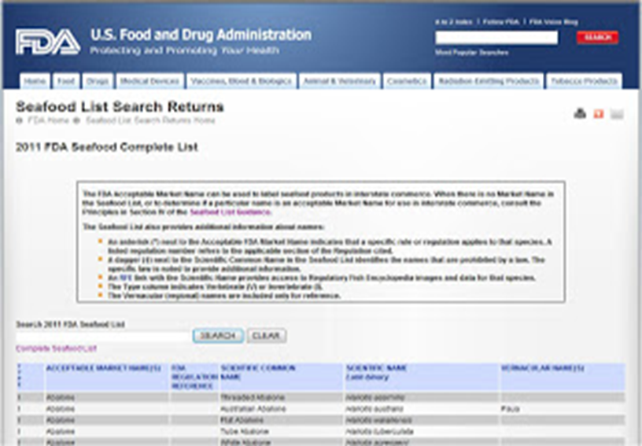
2. Products are correctly labeled for identity and that species are not substituted in any manner
All fish should be labeled according to the FDA seafood list and acceptable market names should be used.
We will work with our customers so they understand the importance of using the names we provide for the products sold to their company.

Slide 12
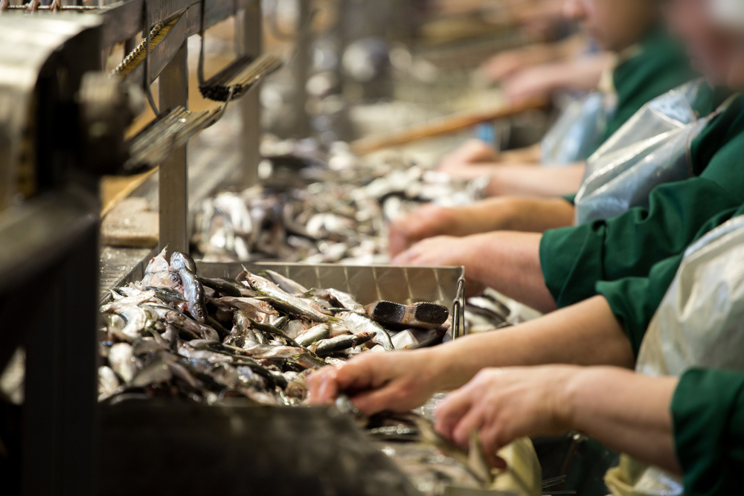
2. Products are correctly labeled for identity and that species are not substituted in any manner – what does that mean for your team?
Labels always accurately reflect the species contained within the package.
Maintain identity of species throughout processing.
Understand and follow procedures for ensuring products are properly labeled.

Slide 13
3. Products are correctly labeled for the country of origin – what does that mean?
Unprocessed fish and shellfish sold at retail in the United States are required by federal regulations to be labeled with their country of origin.
For fish and shellfish, the label must also state the method of production, whether that is wild caught or farm raised.
The language and format used on labels must be in compliance with federal regulations.
The country of origin may change due to processing and staff must be educated to recognize and document the change.
Good records for tracing the country of origin, including shipping records, must be maintained.

Slide 14
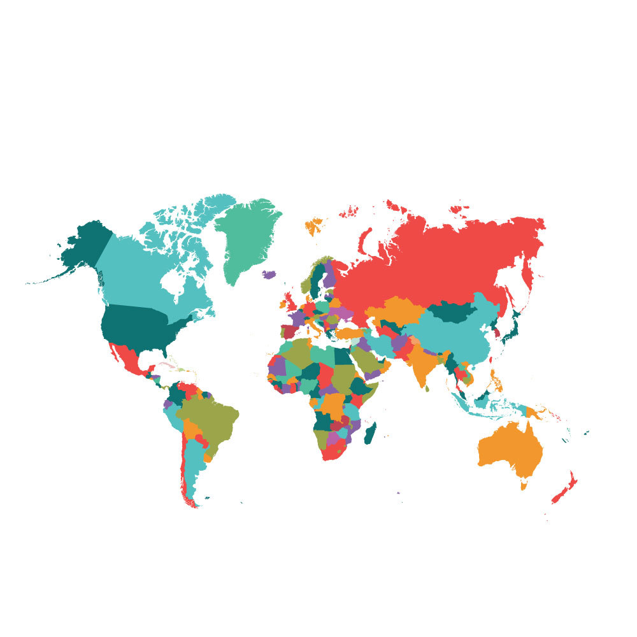
3. Products are correctly labeled for the country of origin – what does that mean?
Labels always accurately reflect the correct country of origin.
Understand and follow procedures for ensuring products are properly labeled with correct country of origin.

Slide 15
4. Products adhere to all other labeling laws – what does that mean?
In addition to those labeling laws mentioned so far, fish and shellfish are required to adhere to all other labeling laws for food service and retail in the country in which the products are sold (e.g., nutritional labeling).
Labels should steer clear of misleading claims, e.g., that the product contains no additives or preservatives, when it actually does.
Health claims on retail packaging must be reviewed and verified for regulatory compliance.
All added ingredients must be approved and safe for use in food and listed on the label.
The buyers’ product specifications must clearly state the functionality and expectations for added ingredients.

Slide 16
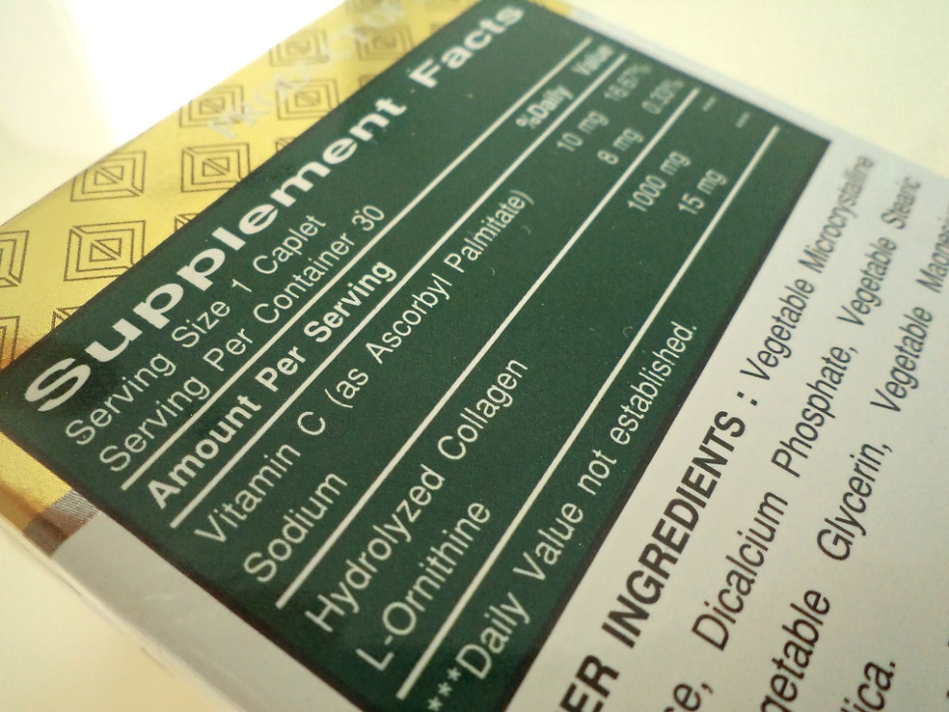
4. Products adhere to all other labeling laws – what does that mean for your team?
Understand and follow procedures for ensuring products are labeled with correct labels and ingredient statements.

Slide 17
In summary
By following these and other guidelines for economic integrity, your company will be honoring the BSB pledge.
Thank you for your commitment to better serving your customers in an honest and trustworthy manner.

Slide 18
Definitions
FDA Seafood List - FDA’s guide to acceptable market names for fish (by species) sold in Interstate Commerce.
Food Safety Modernization Act (FSMA) - FSMA was signed into law in 2011 and gives FDA new authorities to regulate the way foods are grown, harvested and processed.
Glazing (ice covering) - Glazing is the term used to describe the application of a protective coating of ice (ice glaze) to frozen seafood products. The ice layer excludes air from the surface of the product, reducing the rate of oxidation.
Risk assessment - A process to identify potential hazards and analyze what could happen if a hazard occurs.
Traceability (traceback) - Maintaining purchasing or shipping records as documentation to trace the origin and/or method of production of seafood product.
Unprocessed - A fish product is not substantially altered, e.g., cleaning, cutting, mincing, freezing, deep freezing and thawing.

